Slide 1

PREMIER LEAGUE 18/19
THE NECK & NECK RACE

Slide 2
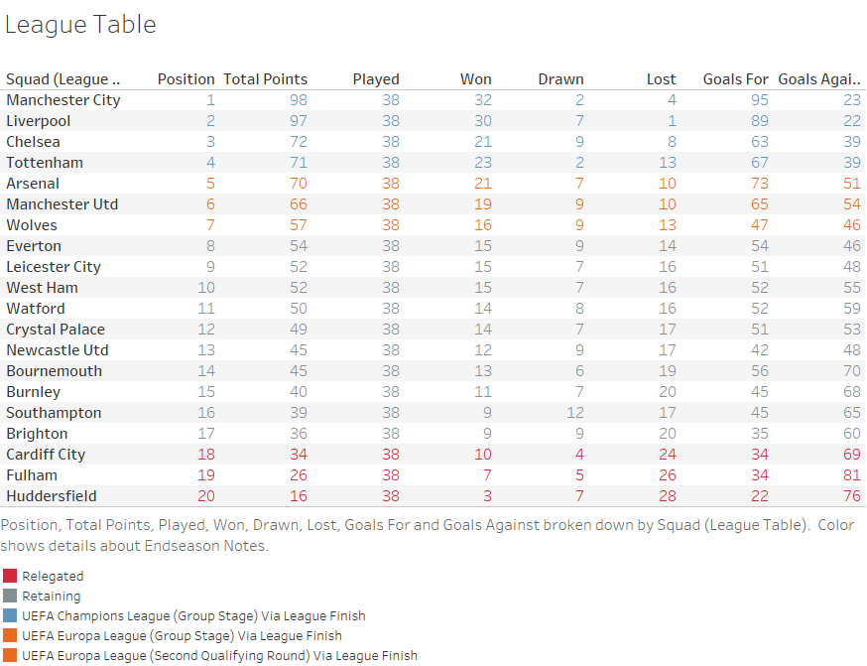
DOWN MEMORY LANE
Looking back at the previous season, we saw one of the closest races in the last 5 years.
Manchester City after running away with it in the last two seasons, had a fierce competitor in Liverpool in the 2018/2019 season. The race went down to the wire on the last match day and Manchester City won by a mere point.
We will look at the underlying factors of how Manchester City was able to pull ahead of Liverpool in order to win the league.

Slide 3
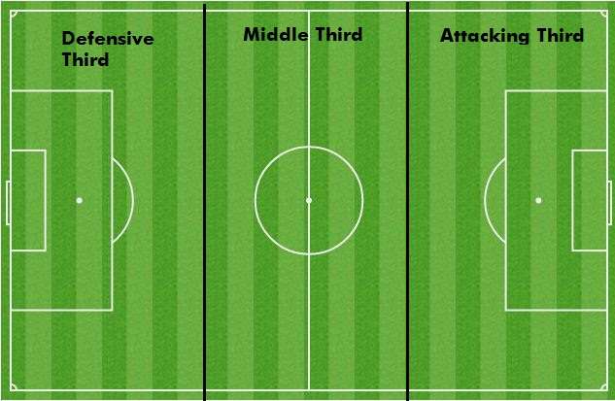
SLICING UP THE PITCH
The pitch will be dissected into thirds and the performance of each squad will be analyzed respective to the positional players present.
The fortitude, strength and resilience of the defense.
The efficiency, control and creativity of the midfield.
The effectiveness and ruthlessness of the attack.

Slide 4
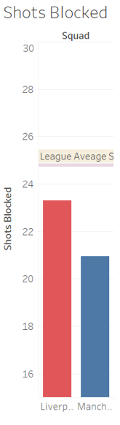
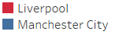
DEFENSE – SHOT BLOCKED
Both teams were below the league average in blocking shots.
An interesting discovery considering the number of goals conceded by each team were amongst the lowest in the league if not the lowest.
In order to understand the performance of these two teams, a deeper analysis using more complex defense metrics must be performed.

Slide 5
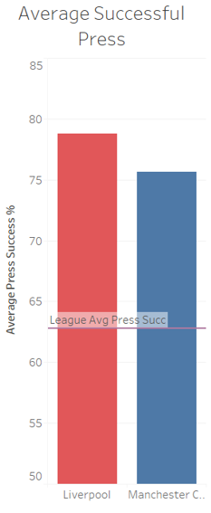
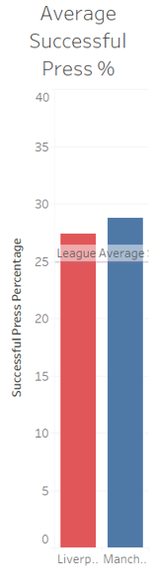
DEFENSE – PRESSING
Successful Press (regaining possession within 5 seconds)
The ability to successful pressure the opposing team is key to a team’s defensive strategy
Effective pressing limits options, disrupts rhythm and hinders creativity for play build up.
It is clear these two teams performed above the league average and more successfully with regards to their pressing. This surely helped kept their opponents from penetrating their third of pitch and scoring against them.

Slide 6
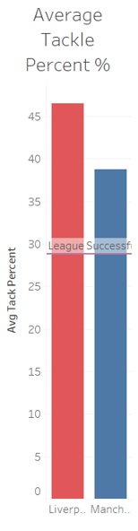
DEFENSE – tackling
Both teams were efficient and effective in their tackling.
Possible cause of less shots blocked (below average for both teams).
Both teams have a strong defensive scheme which limited their opponents’ time on the ball, creation (crosses, through balls, etc.) and opportunities to score.
Combining with an effective pressing and group tackling is a great foundation for a strong defense.

Slide 7
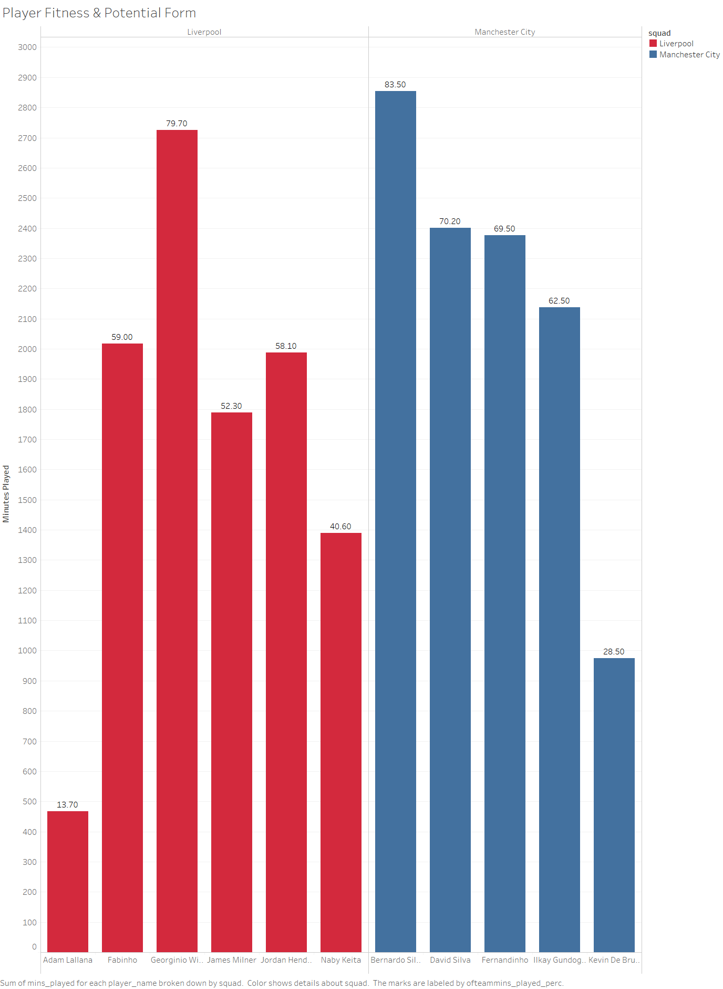
MIDFIELD – FITNESS & FORM
Diving into the engine of the team, the midfield, it is important not to overwork it.
Minutes should be spread throughout the midfield players the squad counts on, day in day out. Relying on individual(s) too much can burn them out resulting in them performing poorly.
Though both Liverpool and Manchester City’s spread of minutes is ideal, the minutes played per match is higher for Manchester City allowing

Slide 8
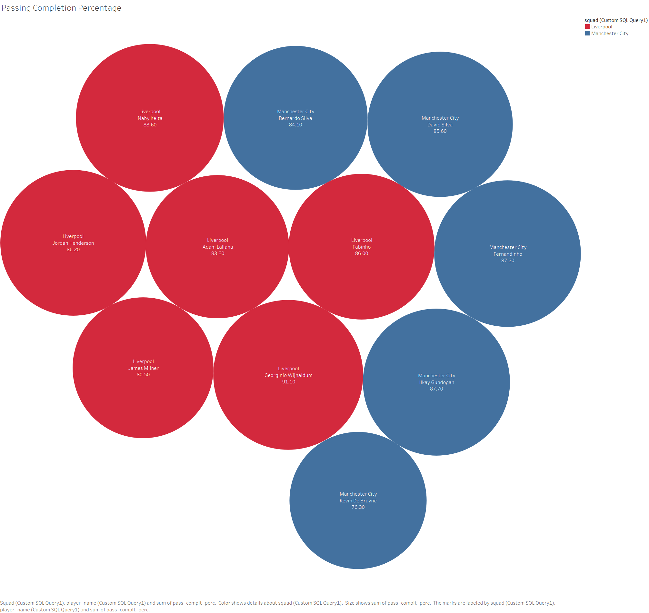
MIDFIELD – PASSING
Passing is an important aspect of the game, especially in the midfield.
Passing leads to more possession, more control, and down the line, opportunities to create chances; whether it is for shots or goals.
Looking at the overall passing completion rate, it can be observed that both groups of midfielders have been accurate with their overall passing.

Slide 9
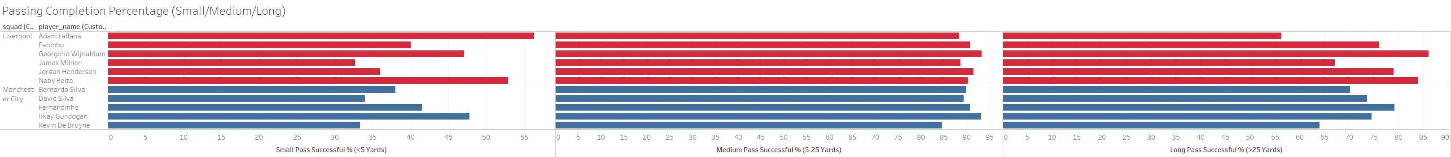
MIDFIELD – PASSING
Diving deeper into passing stats, it can be observed that each team held their composure and had a strong presence in the midfield due to their strong passing

Slide 10
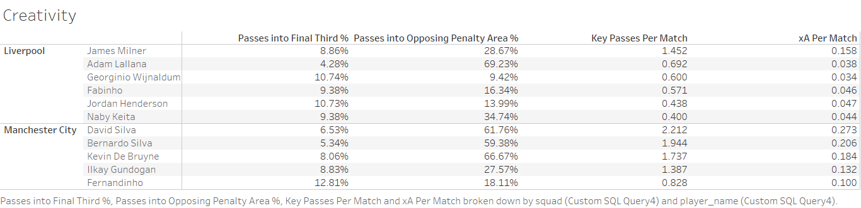
MIDFIELD – CREATIVITY
Creativity is vital in order to break down the opposition.
Playing the ball progressively needs to be down consistently, especially into the opposition penalty area. Key Passes (passes that lead to shots) are a must if the forwards are to score
Both teams were active in bringing play into the final third and the opposition penalty area
Only Manchester City midfielders were effective in being creative and providing important opportunities, evident in high Key Passes and Expected Goals Assisted (xA) per match numbers.

Slide 11
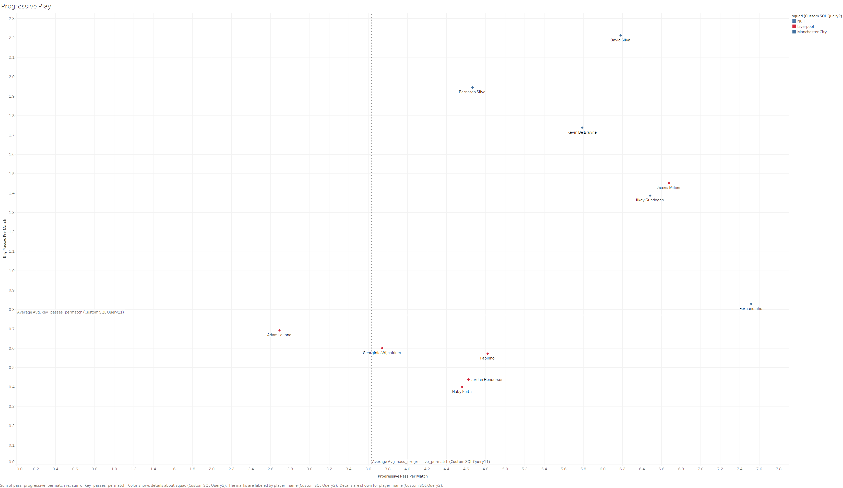
MIDFIELD – PROGRESSIVE PLAY
The higher the position of the plot point, the better the midfielder is to progress the play forward and penetrate the opposition with important chances.
All Manchester City players performed at much higher level, well above the league averages for players while Liverpool were below average.
The Liverpool forwards were not getting the same level of service as Manchester City forwards which may have led to lesser goals scored.

Slide 12
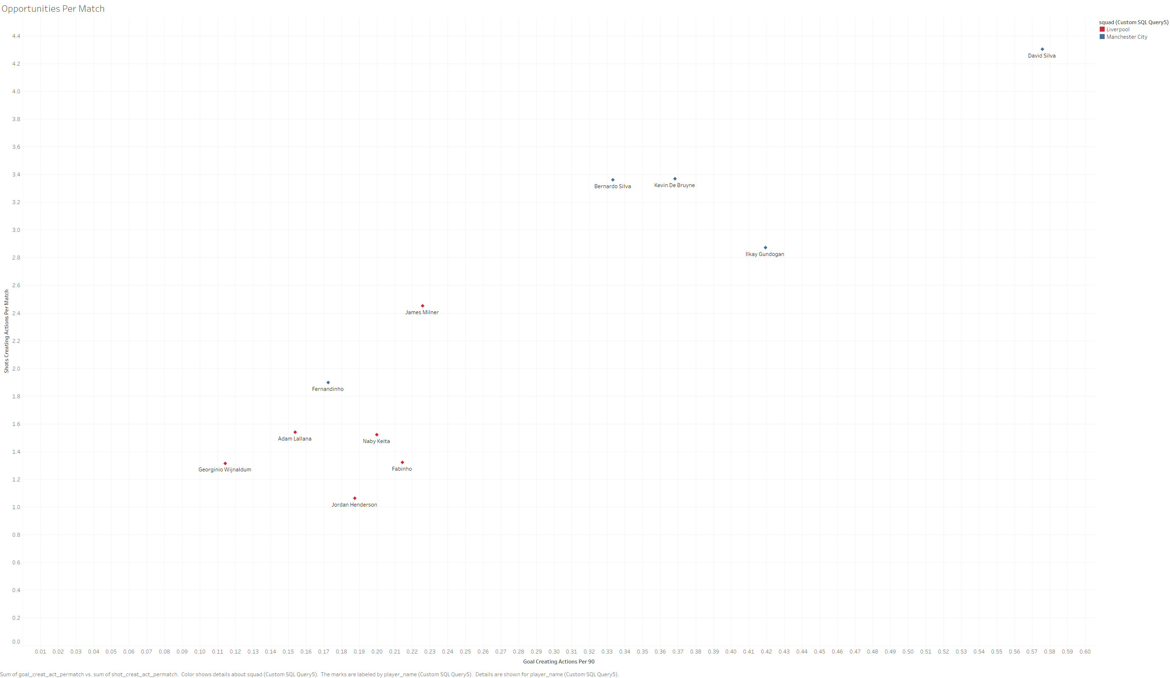
MIDFIELD – OPPORTUNITIES
The higher the position of the plot point, the better the midfielder is at creating chances and providing goal scoring opportunities for his attacking teammates.

Slide 13
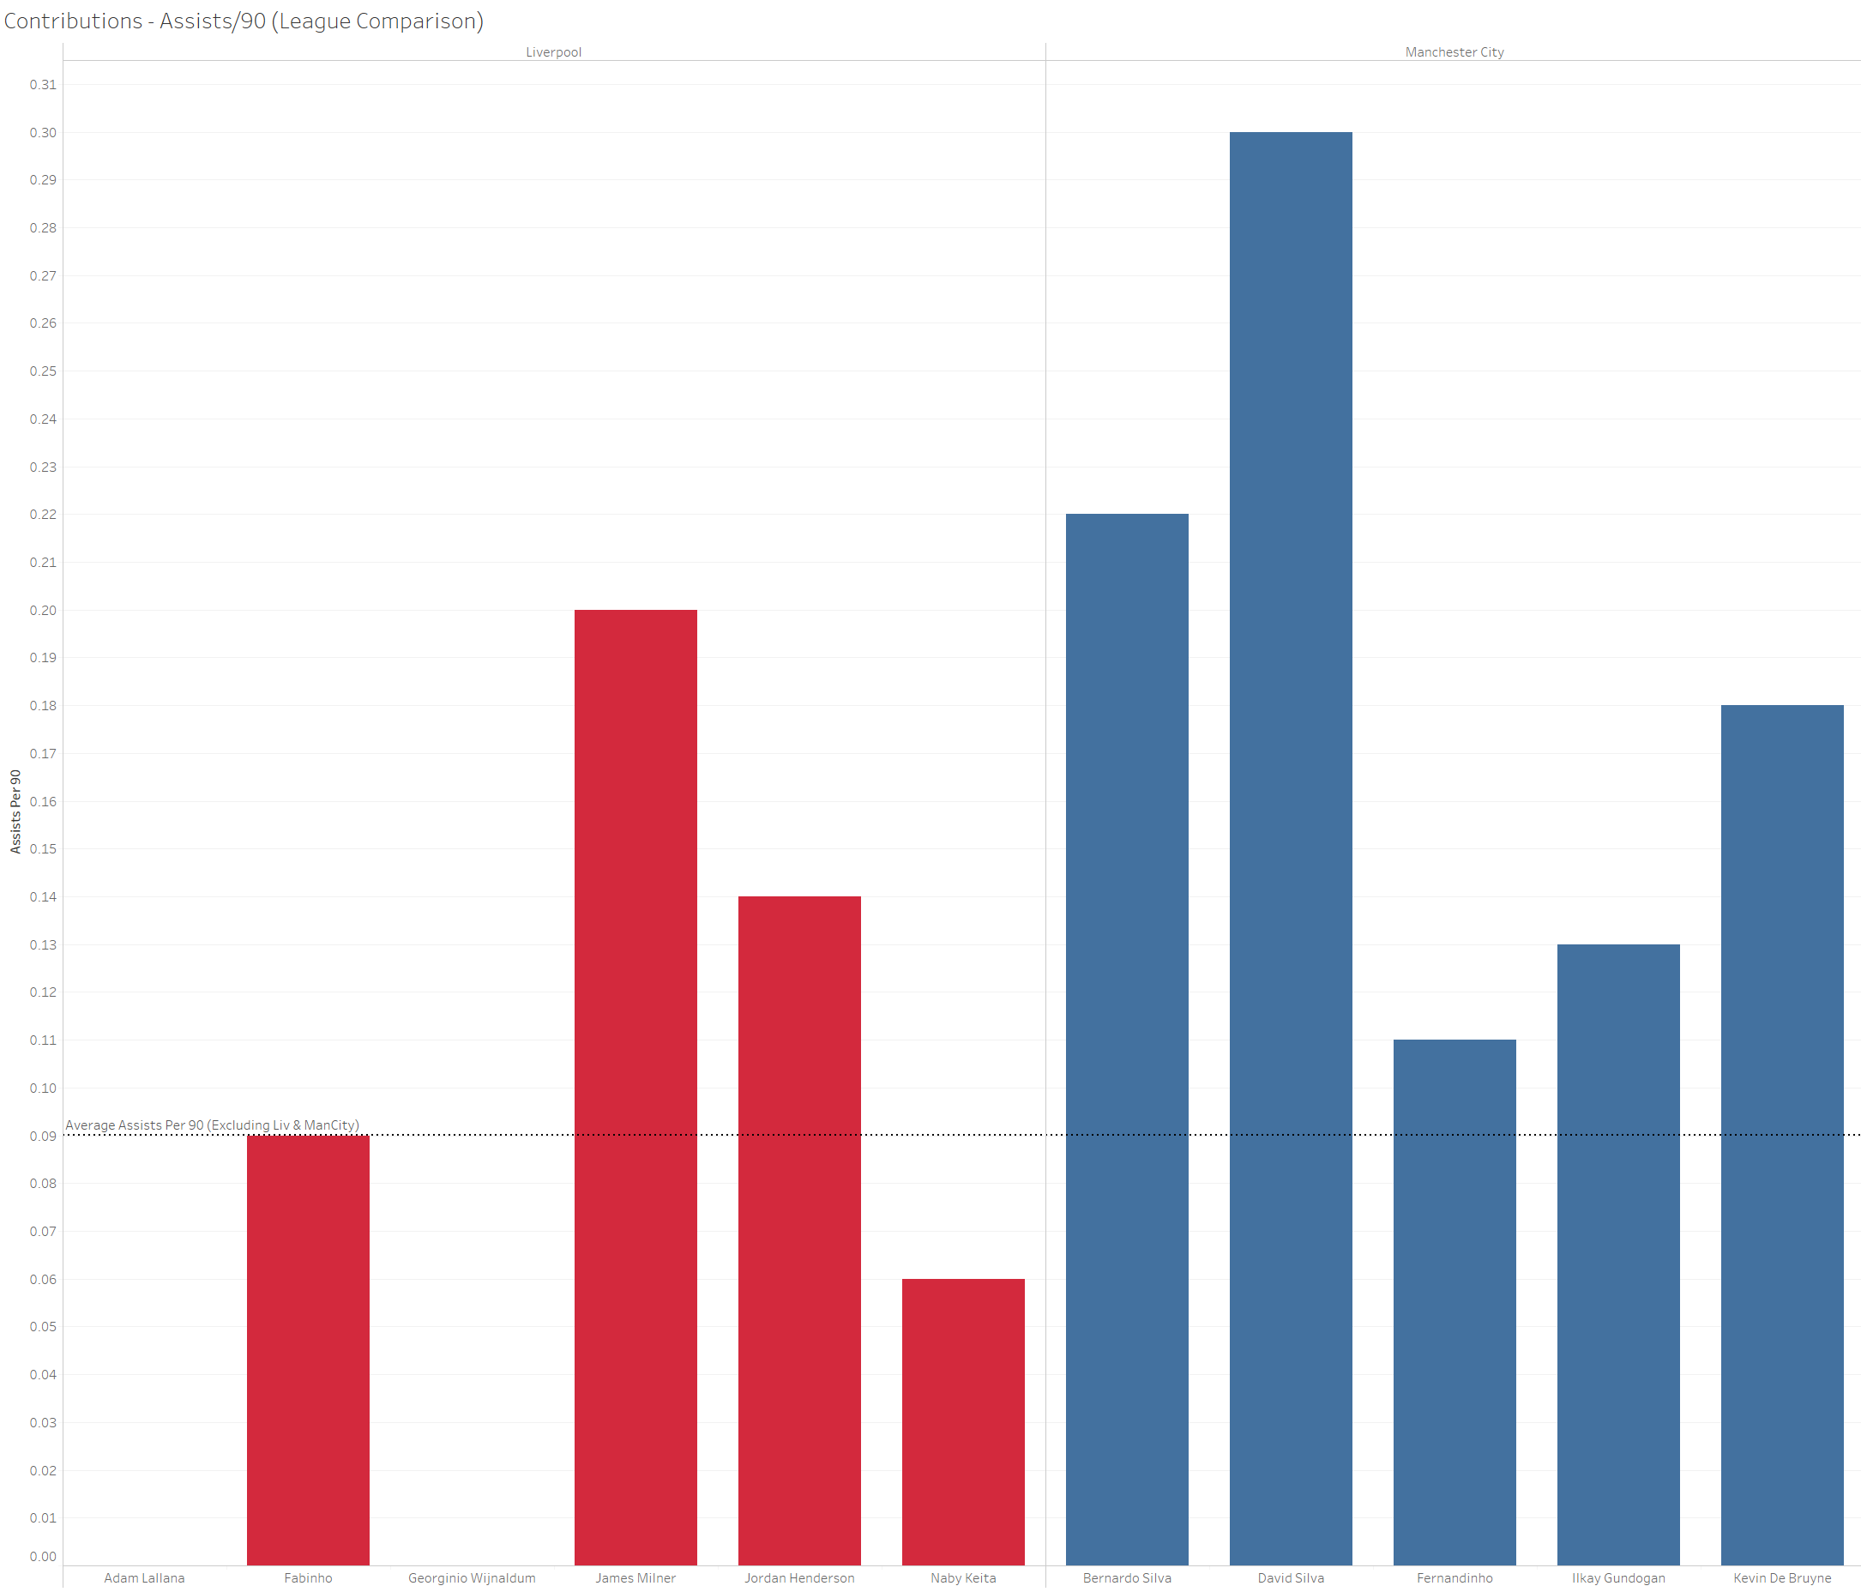
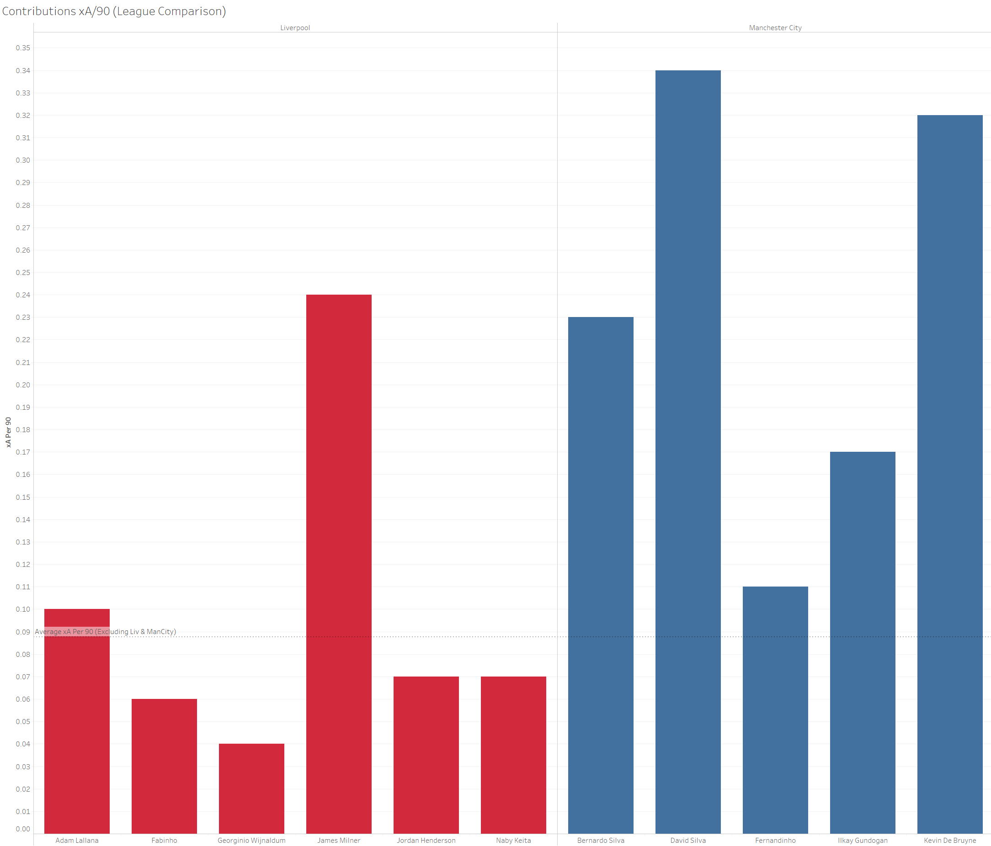
MIDFIELD – CONTRIBUTIONS (Assists)

Slide 14
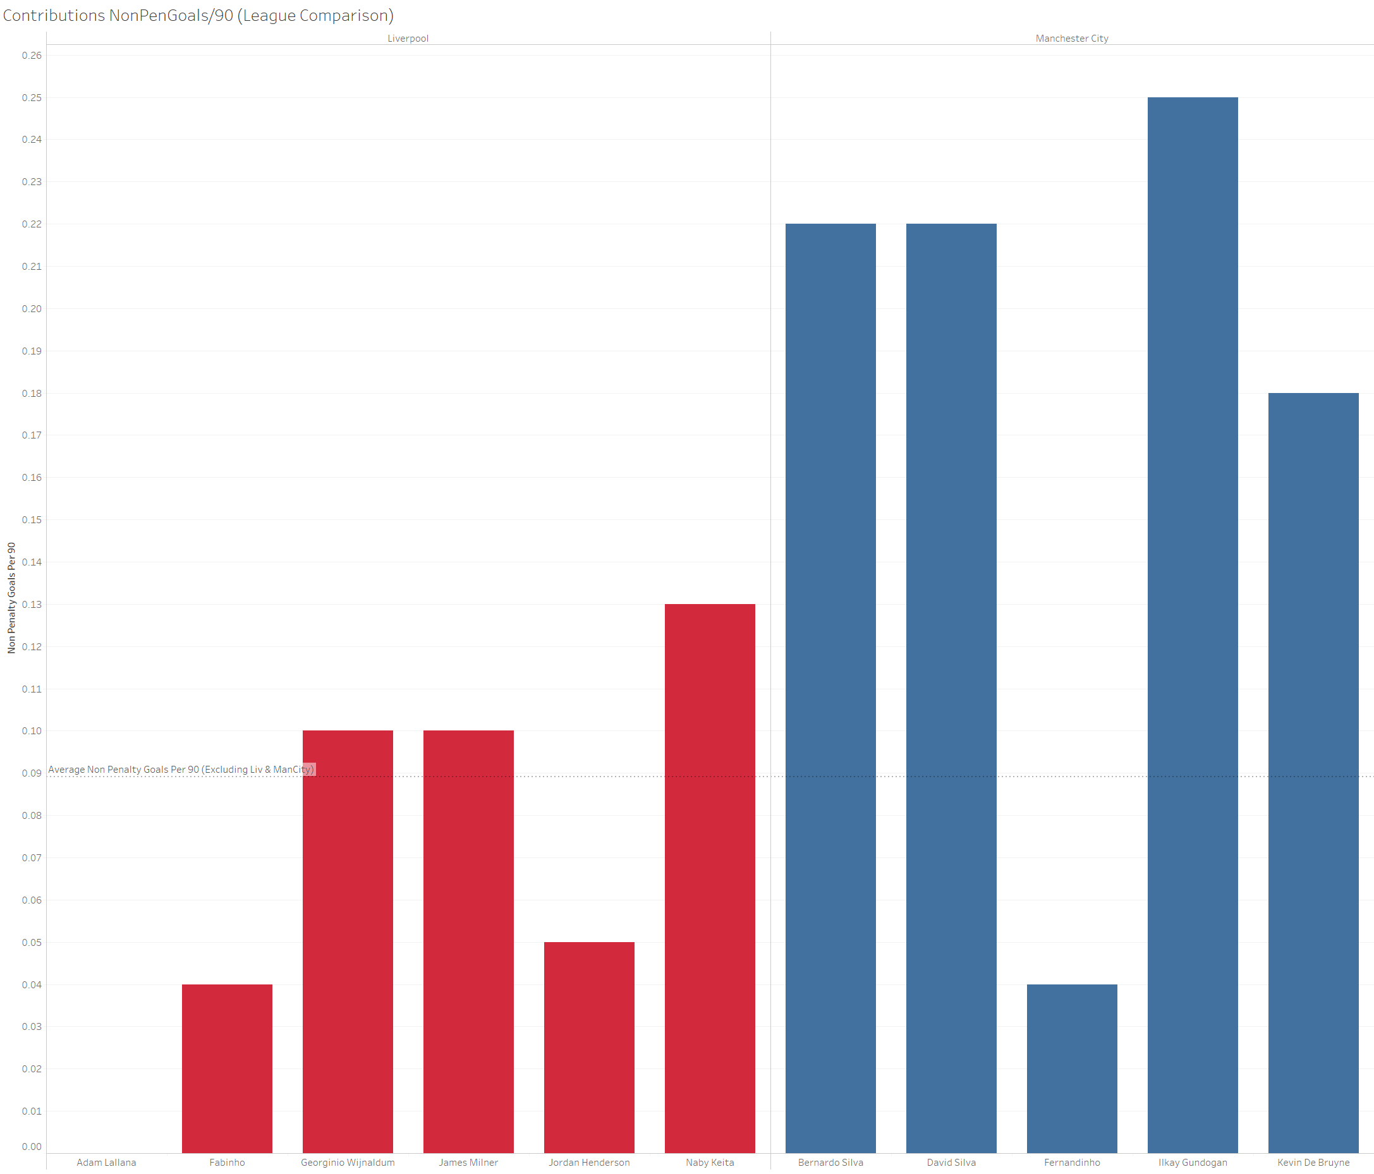
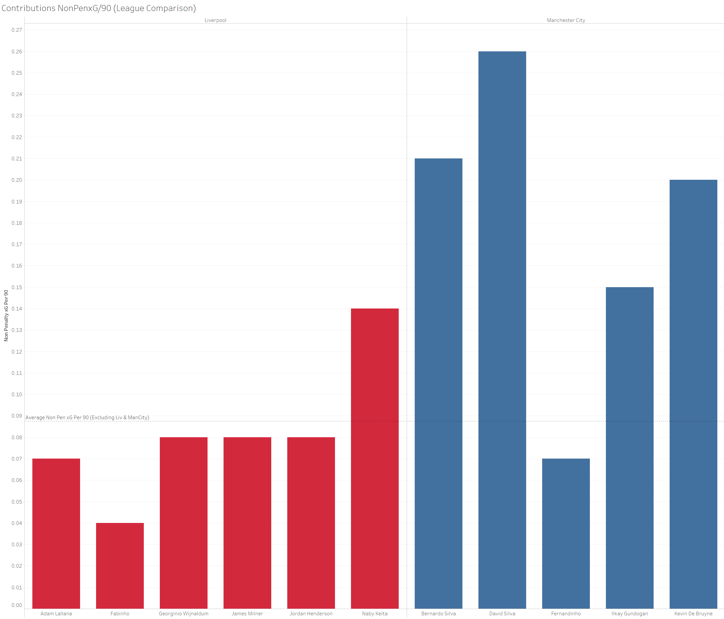
MIDFIELD – CONTRIBUTIONS (GOALS)

Slide 15
MIDFIELD –CONTRIBUTIONS
Due to their higher quality of chance creation and ball progression, Manchester City Midfielders created more chances for goals as seen by the higher xA/90 numbers.
As a result of larger amount of chances created, they also provided more assists to their forwards.
Furthermore, whenever the forwards could not rise to the occasion, the midfielders would step in to provide goals as well.
Liverpool struggled in this regard which can been evident in their below par numbers when compared to Manchester City. In some cases, their numbers look even worse when compared to the rest of the league, either on or below the averages.
Manchester City’s Midfield performed admirably, playing their role in creating and controlling while stepping up when the occasion demanded it.

Slide 16
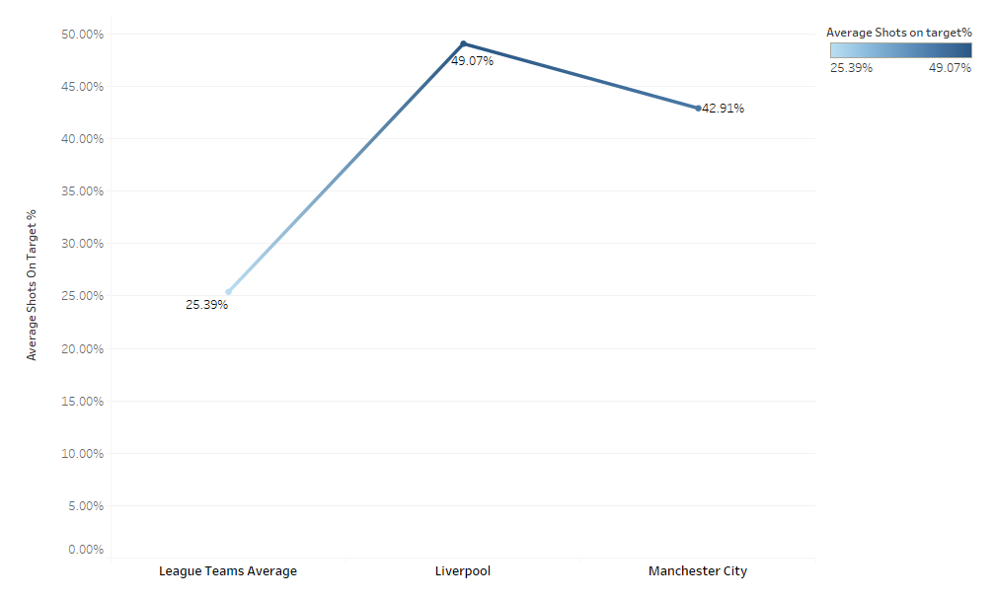
ATTACK – SHOTS ON TARGET
The statistics show that Manchester City and Liverpool were the superior teams by a wide margin.
Shots on Target (SOT) meaning the number of shots taken landing on target (the goal) excluding goalpost or crossbar contacts
Liverpool performed better than Manchester City as in this case regardless of whether these shots were converted or not.

Slide 17
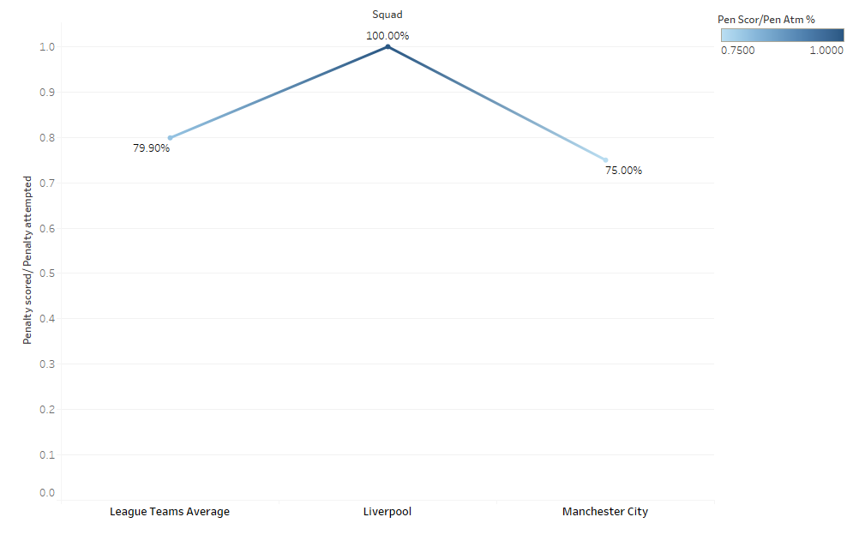
ATTACK – LETHAL ON PENALTIES
Analyzing the total number of penalty kicks awarded to both teams, it can be seen that Liverpool had a better penalty conversion rate (4 of 4) while Manchester City did not (3 of 4)
Was Liverpool the better team?
Certainly not, as Manchester City scored a total of 95 goals at the end of the season which was 6 more than that of Liverpool.

Slide 18
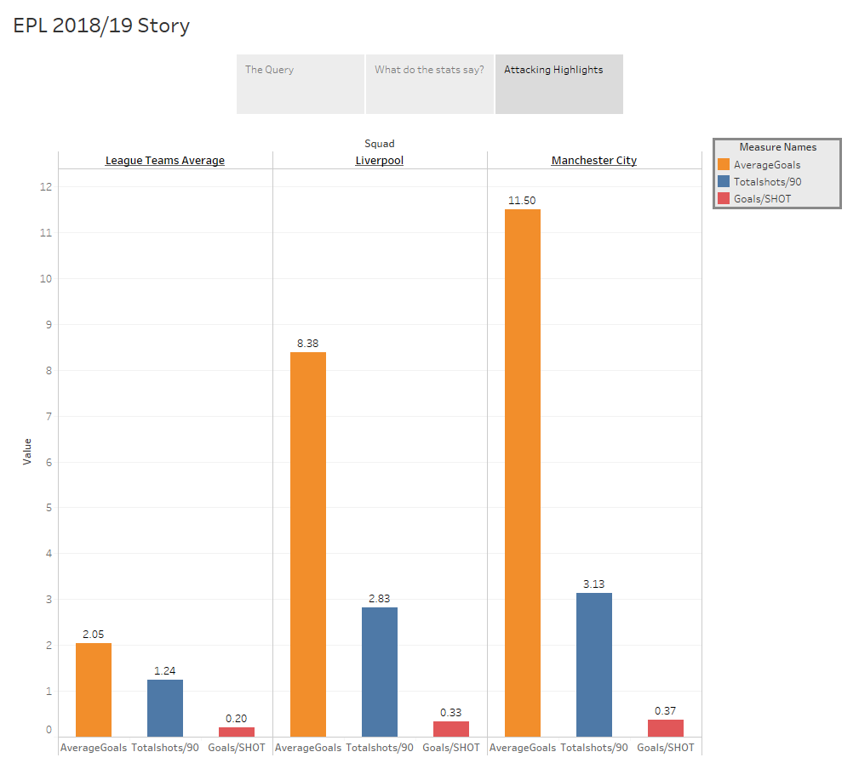
ATTACK – Effective Attack
We can conclude that even though Liverpool had a better Shots on Target Percentage, they were not able to convert their shots into goals.
In contrast to Liverpool’s performance, Manchester City was able to convert most of the Shots on Target into goals which was one of the deciding factors in Manchester city outperforming Liverpool and outclassing the rest of the league.

